Slide 1

WHITE WINE DATA Analysis
Prepared By: Priya P Surendran
ID:1533656

Slide 2
Dataset introduction
Input Attributes
Fixed Acidity(g/dm³)
Volatile Acidity(g/dm³)
Citric Acid (g/dm³)
Residual Sugar(g/dm³)
Chlorides(g/dm³)
Total Sulfur Dioxide(mg/dm³)
Density(g/cm³)
pH
Sulphates(g/dm³)
Alcohol(percentage by volume)
Output Attribute
Quality(scale of 0-10)
White wine variants of Portuguese “Vinho Verde” wine
Dataset contains 12 attributes and 4898 instances.
11 are input attributes based on the physicochemical tests
One output attribute which based on sensory data
The purpose of this analysis is to determine what physicochemical properties affect white wine quality .

Slide 3
Data Import
#Import Libraries
library(ggplot2) #Data visualization
library (gridExtra)# laying multiple plots on a page
library(GGally)#for scatter plot matrix visualization
library(dplyr) # efficient manipulation of dataset
library(reshape2) # flexibly reshape data
library(RColorBrewer)# color palettes for graphing
install.packages("e1071")
library(e1071)#skewness and kurtosis
install.packages("corrplot")
library(corrplot)#for graphically displaying correlation matrix
# Read the data
Wine_List<- read.csv("whitewine.csv",na.strings="")

Slide 4
Data Cleansing
#Data elaboration and cleaning
class(Wine_List)
names(Wine_List)
str(Wine_List)
#missing value analysis
sum(complete.cases(Wine_List)) ))# no NA values
#Check for duplicates and remove it
sum(duplicated(Wine_List))
Wine_List <- Wine_List[!duplicated(Wine_List), ]
# converting mg/dm3 to g/dm3
Wine_List$free.sulfur.dioxide<-.001*Wine_List$free.sulfur.dioxide
Wine_List$total.sulfur.dioxide<-.001*Wine_List$total.sulfur.dioxide

Slide 5
Data preprocessing
#Creating a new Factored Variable called 'Rating’
Wine_List$rating <- ifelse(Wine_List$quality < 5, 'bad', ifelse( Wine_List$quality < 7, 'average', 'good’))
Wine_List$rating <- ordered(Wine_List$rating,
levels = c('bad', 'average', 'good’))
#Adding label as alcohol percentage to group the alcohol concentration
Wine_List$label <- ifelse(Wine_List$alcohol <=9, 'light', ifelse(
Wine_List$alcohol <=12, 'medium', 'strong’))
Wine_List$label <- ordered(Wine_List$label,
levels = c('light', 'medium', 'strong'))

Slide 6
Univariate Analysis
Frequency
table(Wine_List$rating)
bad average good
173 2963 825
table(Wine_List$quality)
3 4 5 6 7 8 9
20 153 1175 1788 689 131 5
table(Wine_List$label)
light medium strong
315 3031 615

Slide 7
Univariate Analysis
Percentage
100*(table(Wine_List$rating)/sum(table(Wine_List$rating)))
bad average good
4.367584 74.804342 20.828074
100*(table(Wine_List$quality)/sum(table(Wine_List$quality)))
3 4 5 6 7 8 9
0.5049230 3.8626609 29.6642262 45.1401161 17.3945973 3.3072456 0.1262307
100*(table(Wine_List$label)/sum(table(Wine_List$label)))
light medium strong
7.952537 76.521081 15.526382

Slide 8
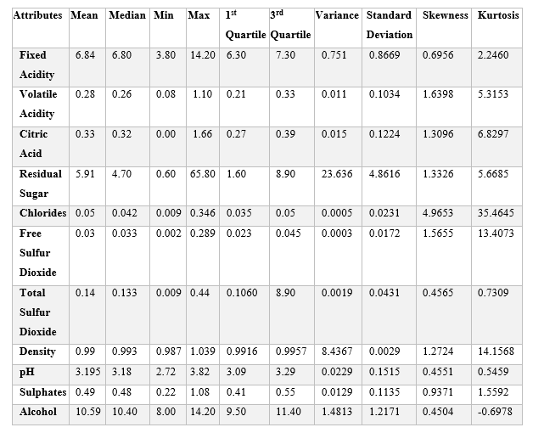
Univariate Analysis

Slide 9
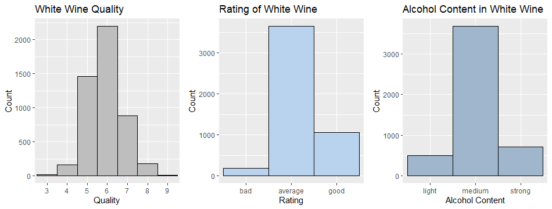
Univariate Analysis
Bar Chart

Slide 10
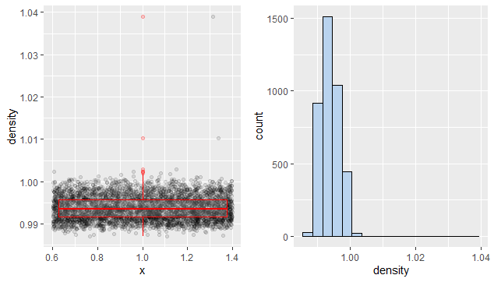
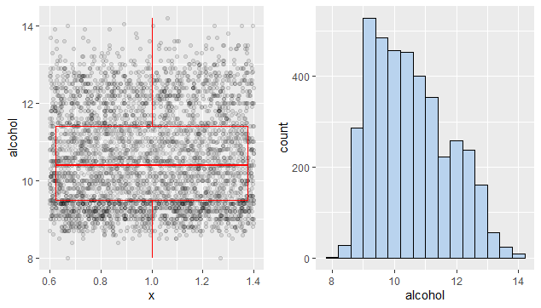
Univariate Analysis
Histogram & Boxplot of Density
Histogram & Boxplot of Alcohol

Slide 11
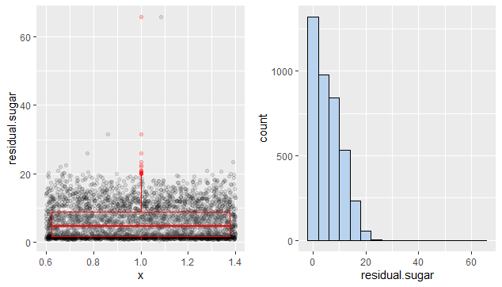
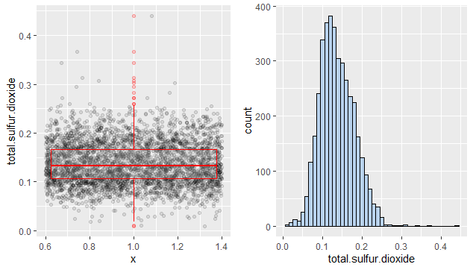
Univariate Analysis
Histogram & Boxplot of Residual Sugar
Histogram & Boxplot of Total Sulfur Dioxide

Slide 12
Bivariate Analysis
Frequency
table( Wine_List$rating, Wine_List$label)
light medium strong
bad 23 140 10
average 271 2409 283
good 21 482 322

Slide 13
Bivariate Analysis
Percentage
100*(table(Wine_List$rating, Wine_List$label)/sum(table(Wine_List$rating, Wine_List$label)))
light medium strong
bad 0.5806614 3.5344610 0.2524615
average 6.8417066 60.8179753 7.1446604
good 0.5301691 12.1686443 8.1292603

Slide 14
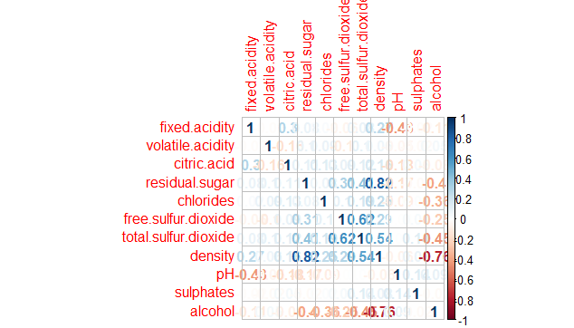
Bivariate Analysis
Correlation
Major Correlation
density-alcohol
density-total sulfur dioxide
residual sugar-alcohol
density-residual sugar

Slide 15
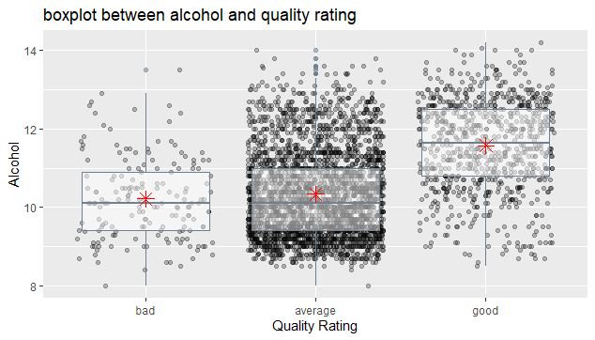
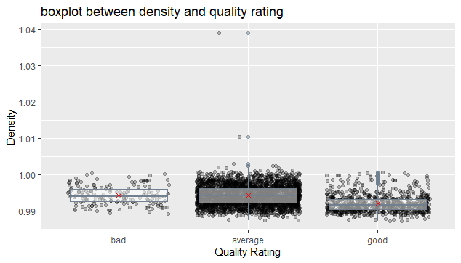
bivariate Analysis

Slide 16
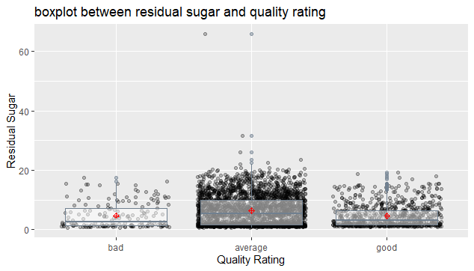
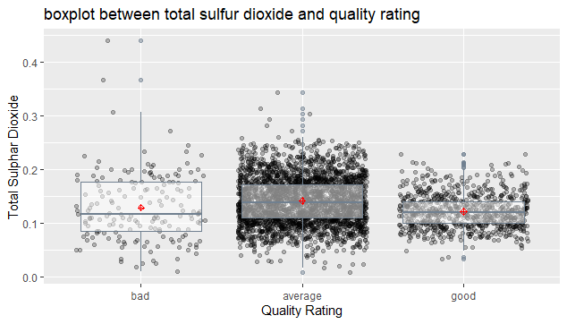
bivariate Analysis

Slide 17
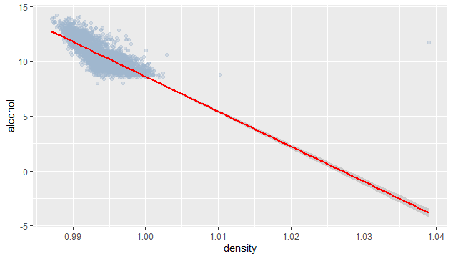
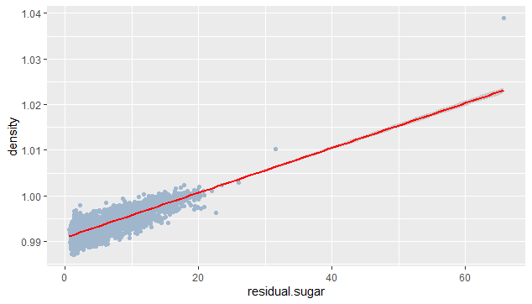
bivariate Analysis Scatter Plot and linear regression

Slide 18
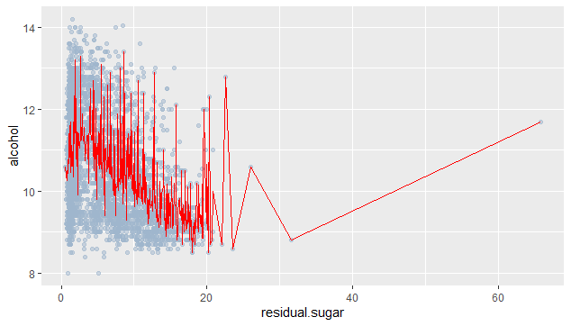
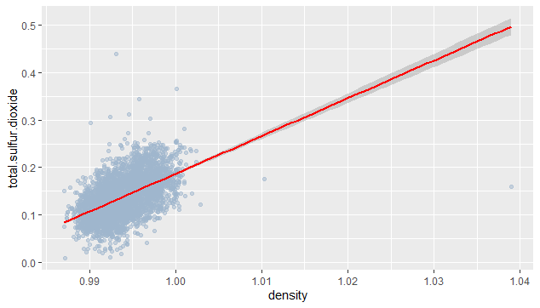
bivariate Analysis Scatter Plot and linear regression

Slide 19
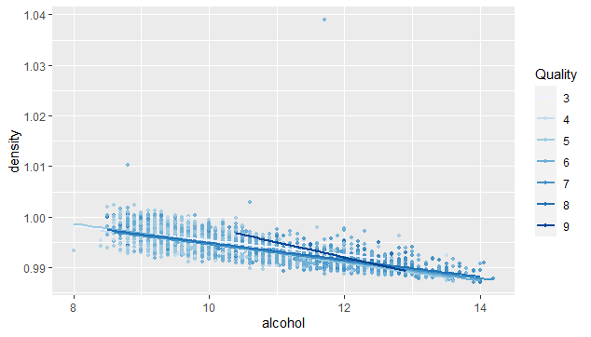
Multivariate Analysis
There is a strong relation between alcohol , density and wine quality
Higher quality wines have less density and strong alcohol content.

Slide 20
Result Interpretation
Major physicochemical attributes affecting wine quality are density, alcohol, sulfur dioxide.
Volatile acid like acetic acid should be less since it causes bitterness to wine.
There should be an optimum quantity of citric acid as it add freshness to wine.
Lesser level of chlorides is preferred in wine.
Wine density should be less and high amount of sulfur dioxide will increase the density. Maximum sulfur dioxide content should be up to 50.
Alcohol in wine should be strong to improve the quality. As alcohol content increase, it decrease the density and the sugar content of wine.
No relation between residual sugar and quality of wine as discussed in univariate data analysis.

Slide 21
Conclusion
Experts who rated the white wine quality in the dataset preferred wines with more alcohol, less sugar, less density, less volatile acid, sulfur dioxide and chlorides.
Major limitation was the quality scale of 10.The quality rating was given between 3 to 9 and most of the rating was between 5 to 7 and made most of the samples as middle quality.
A linear model for quality prediction didn’t perform as expected as the process of finding the quality of wine is subjective.
In future a different set of models like logistic or multiple regression model can be used to find the best features which contributes to the high-quality wine.

Slide 22

Thank You
Questions??

